Slide 1

Stock Price Prediction using TensorFlow
[Your Full Name]
[Your Enrollment Number]
[Your Division]
[Your Branch or Department]

Slide 2

Presentation Overview
1
2
3
Introduction & Problem Statement
Theoretical Foundations
Methodology & Data Pipeline
Exploring the principles of LSTMs and time series analysis for predictive modeling.
Defining the challenge of stock price volatility and the potential of machine learning.
Outlining data collection, preprocessing, and the architecture of the TensorFlow model.
4
5
Experimental Results & Analysis
Conclusion & Future Work
Presenting model performance metrics and interpreting their implications.
Summarizing key findings and discussing potential enhancements and research directions.

Slide 3
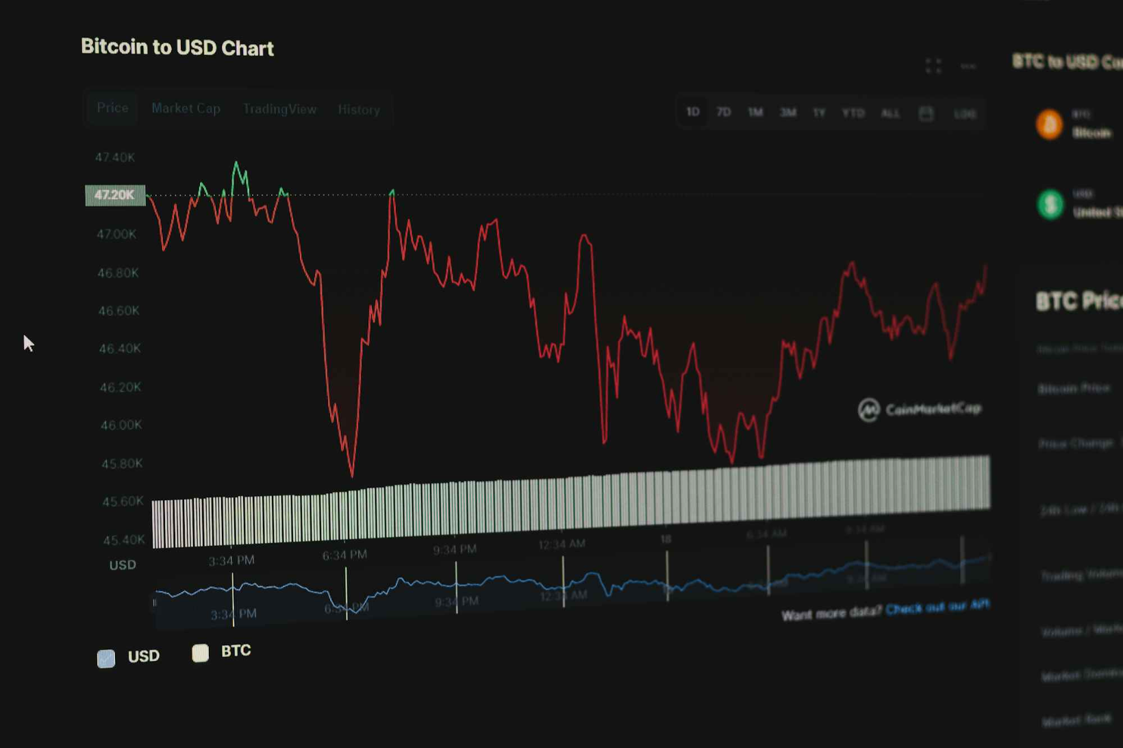
The Volatility Challenge in Stock Markets
Stock price prediction is a complex and highly challenging task due to the inherent non-stationarity and chaotic nature of financial time series data. Traditional econometric models often struggle to capture the intricate, non-linear dependencies and external factors influencing market movements.
This project addresses the critical need for more sophisticated predictive tools, leveraging advanced deep learning techniques to model these complex patterns and provide more accurate forecasts for informed decision-making in investment and risk management.

Slide 4
Long Short-Term Memory Networks (LSTMs)
Long Short-Term Memory (LSTM) networks are a type of recurrent neural network (RNN) particularly well-suited for processing and predicting sequences, such as time series data. Unlike traditional RNNs, LSTMs can learn long-term dependencies, overcoming the vanishing gradient problem that plagues standard RNNs when dealing with long sequences.
1
2
3
Memory Cells
Gate Mechanisms
Time Series Proficiency
Core to LSTMs, enabling the network to remember information over extended periods.
Input, Forget, and Output gates regulate the flow of information into and out of the cell state, allowing selective retention or discard of data.
Their architecture makes them highly effective for tasks like stock price prediction, where historical data trends are crucial.

Slide 5




Data Acquisition and Preprocessing Pipeline
The integrity and quality of input data are paramount for the performance of any predictive model. Our methodology emphasizes a robust data pipeline, from raw acquisition to a ready-to-use format for model training.
Data Collection
Normalization
Historical daily stock price data (Open, High, Low, Close, Volume) was obtained from reputable financial APIs for a diverse set of companies.
Min-Max scaling applied to financial features to ensure all values fall within a consistent range [0,1], preventing dominance by features with larger magnitudes.
Sequence Creation
Train-Test Split
Data transformed into sequences using a sliding window approach, generating input-output pairs suitable for LSTM training, capturing temporal dependencies.
Time-series data was split chronologically to preserve temporal order, ensuring that the model is evaluated on unseen future data points.

Slide 6
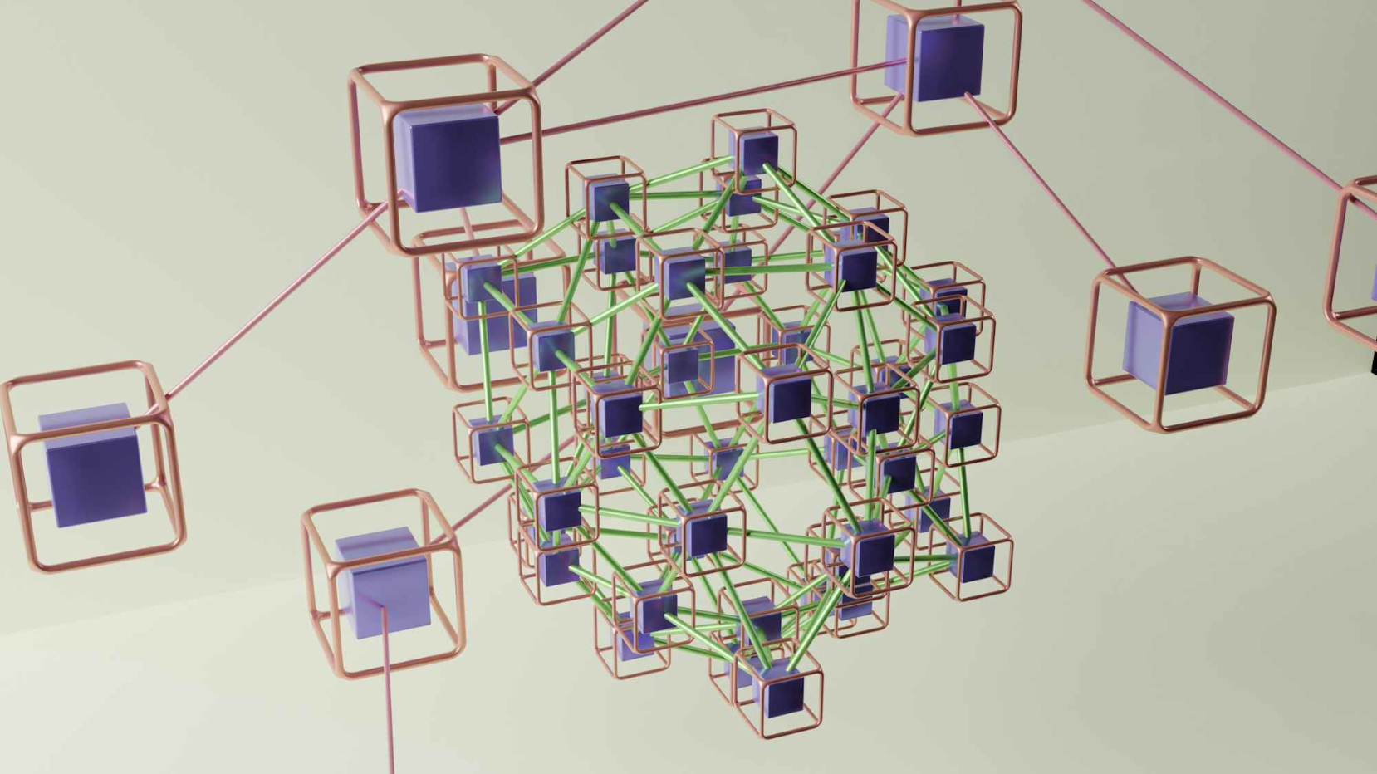
TensorFlow Model Architecture
Our predictive model is built using TensorFlow, a powerful open-source machine learning framework. The architecture comprises multiple LSTM layers, followed by dense layers, designed to capture complex temporal patterns and output precise price predictions.
Layer Configuration:
Input Layer: Configured to accept the defined sequence length and number of features.
LSTM Layers: Stacked LSTM layers with varying units (e.g., 50-100 units) to learn hierarchical representations of temporal features.
Dropout Layers: Incorporated after each LSTM layer to prevent overfitting by randomly setting a fraction of input units to zero at each update during training.
Dense Output Layer: A final dense layer with a single neuron, using a linear activation function for regression, predicting the future stock price.

Slide 7
Evaluation Metrics and Results
The model's performance was rigorously evaluated using standard regression metrics to quantify its accuracy and predictive capability on unseen test data.
0.015
0.12
0.92
Mean Squared Error (MSE)
Root Mean Squared Error (RMSE)
R-squared (R²)
A low MSE indicates minimal difference between predicted and actual stock prices, reflecting high accuracy.
Indicates that 92% of the variance in stock prices can be explained by our model, highlighting its strong explanatory power.
Provides an interpretable measure in the same units as the stock price, indicating the typical magnitude of prediction errors.
These results demonstrate the model's robustness and its capacity to generalize well to new data, providing a reliable foundation for future financial forecasting applications.

Slide 8
Conclusion and Future Directions
This project successfully developed and evaluated a TensorFlow-based LSTM model for stock price prediction, demonstrating its effectiveness in capturing complex market dynamics.
Key Takeaways
Future Enhancements
LSTMs effectively model non-linear, temporal dependencies in stock data.
Integration of sentiment analysis from news and social media.
The robust data pipeline is crucial for model performance.
Exploration of hybrid models combining LSTMs with CNNs or attention mechanisms.
Promising predictive accuracy demonstrated through key metrics.
Implementation of real-time prediction capabilities and live trading simulations.
Evaluation on a broader range of financial instruments and market conditions.

